Slide 1
DOES THIS MOLE LOOK WEIRD TO YOU?
1/2
Classifying Skin Lesions Through Image Classification
Sashank Yalavarthy, Erick Cohen, Marius Nwobi, Andrew Normandin
Notes:
https://www.kaggle.com/datasets/kmader/skin-cancer-mnist-ham10000

Slide 2
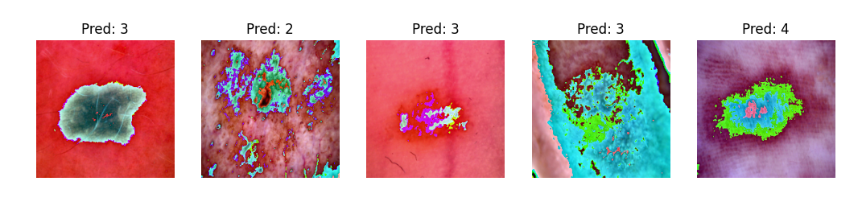
The Dataset
HAM10000 (Human against the machine) contains 10,015 images of pigmented skin lesions.
There are 7 total classes:
3 cancerous classes
4 benign classes
Train-test-val split: 70-15-15
Pre-processing:
Resize to 224x224
Flip Image
Normalize with mean = 0.5, stddev = 0.5

Slide 3
Skin Lesion Class Imbalance
Name
Department Course Number Section Time Location
DATE
Actinic Keratosis
Basal Cell Carcinoma
Melanoma
Benign Keratosis
Dermatofibroma
Bcc
514
Mel
1113
Bkl
1099
Df
115
Akiec
327
Melanocytic Nevi
Vascular Skin Lesion
Nv
6705
Vasc
142
Notes:
Malignant:
Akiec - Actinic Keratoses (Solar Keratoses) and Intraepithelial Carcinoma (Bowen’s disease)
Bcc - Basal cell carcinoma
Mel - Melanoma
Benign:
Bkl - "Benign keratosis"
Df - Dermatofibroma
Nv - Melanocytic nevi
Vasc - Vascular skin lesions

Slide 4
Approaches
EfficientNet-B0 + Classifier Head
EfficientNet-B4 + Classifier Head
ResNet-18 + Classifier Head
Baseline: Simple CNN Classifier
3 Conv2D Layers: 3 -> 32 -> 64 -> 128
MaxPool2D Layer
Dropout Layer
Classifier Head

Slide 5
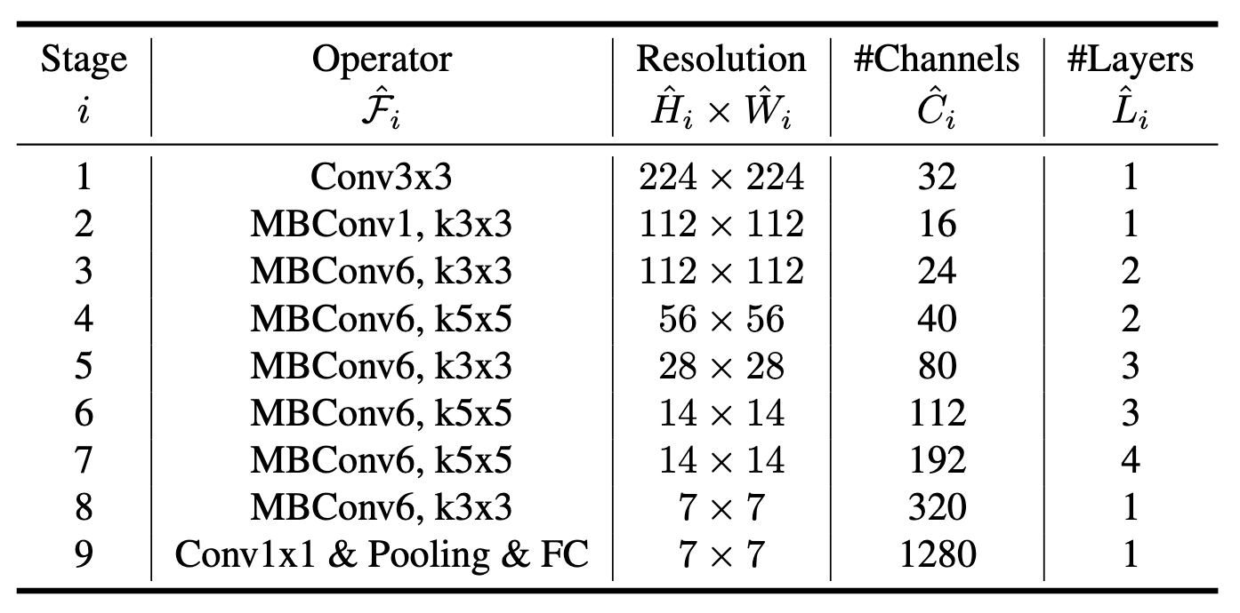
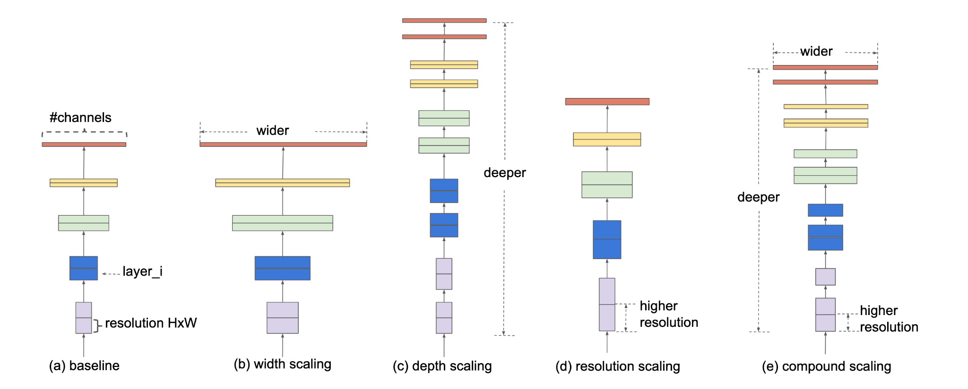
EfficientNet
CNN architectures have 3 important dimensions:
Width, Depth and Resolution
The paper uniformly scales all 3 dimensions, using a highly effective compound coefficient
Uses neural architecture search to design a baseline network and scale it up. This is the EfficientNet family of models.

Slide 6
Results
Model | Train Accuracy | Val. Accuracy | Train Loss | Val. Loss | Test Acc | Test Loss
ResNet-18 | 80.63% | 77.78% | 0.5461 | 0.6129 | 78.43% | 0.6189
EfficientNet-B0 | 83.59% | 79.44% | 0.4601 | 0.5871 | 78.03% | 0.6033
EfficientNet-B4 | 77.99% | 75.58% | 0.6139 | 0.6959 | 76.36% | 0.6680

Slide 7
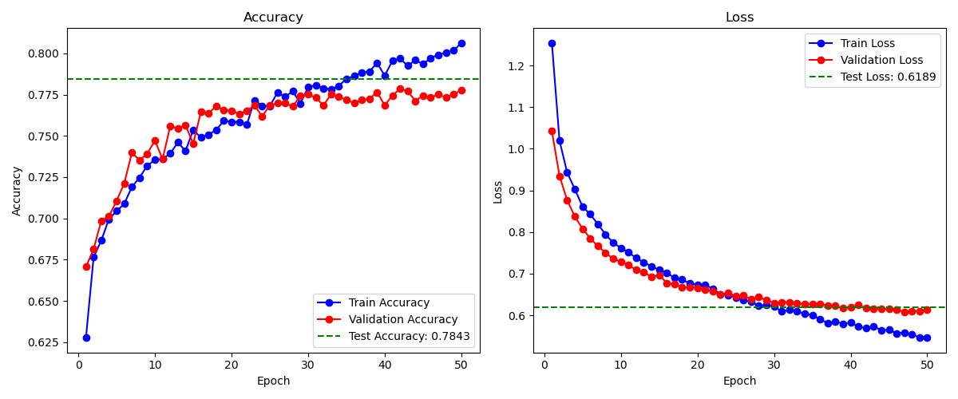
ResNet-18

Slide 8
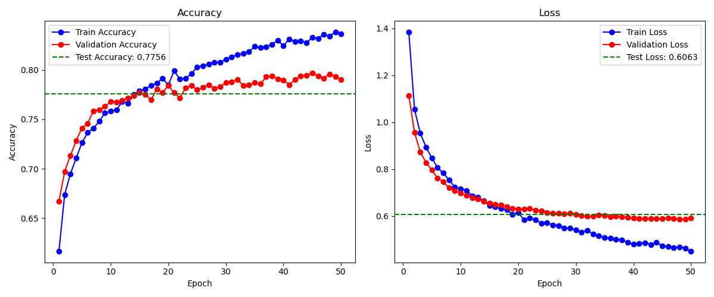
EfficientNet-B0

Slide 9
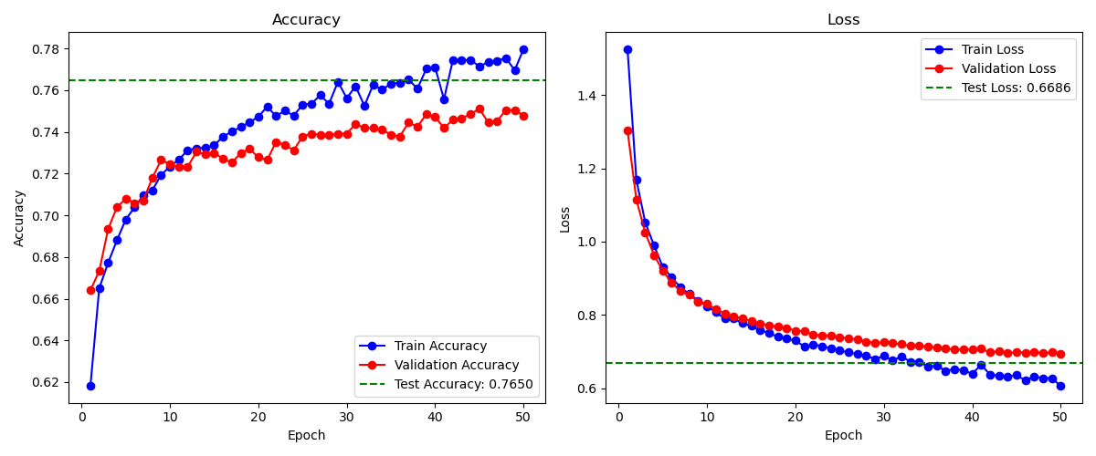
EfficientNet-B4

Slide 10
THANK YOU!
1/2
Classifying Skin Lesions Through Image Classification
Sashank Yalavarthy, Erick Cohen, Marius Nwobi, Andrew Normandin
Notes:
https://www.kaggle.com/datasets/kmader/skin-cancer-mnist-ham10000

